Slide 1
IBM API Connect on IBM Cloud Private

Slide 2
Agenda
IBM API Connect Overview
What’s New in API Connect
IBM API Connect on IBM Cloud Private
Resources

Slide 3
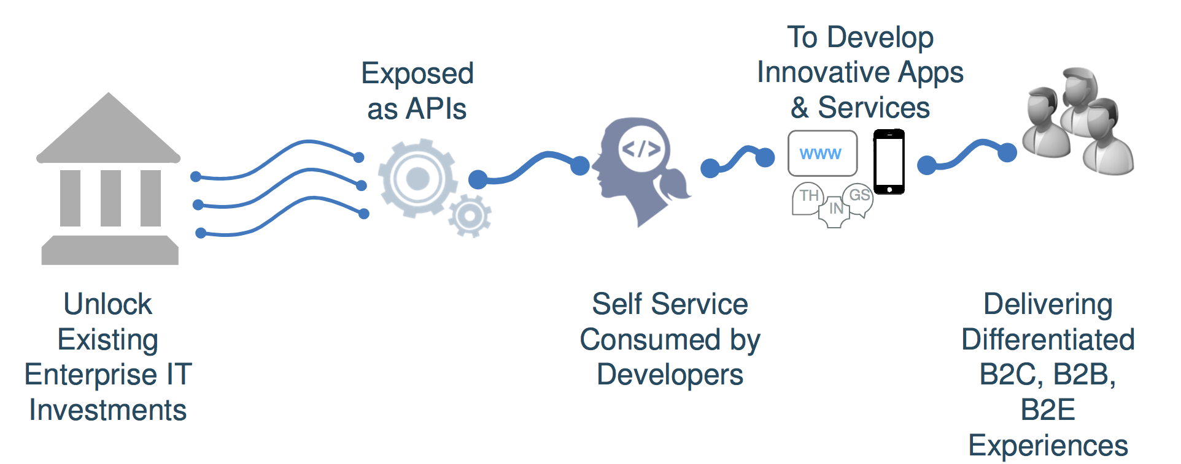
API Economy
Expose functionality as APIs
Make APIs available for reuse internally and externally
Reuse raises ROI, increases competitiveness
Unleashing Enterprise Investments To Disrupt Competitors

Slide 4

What is IBM API Connect?
Create
Automatically create and test APIs to expose data, microservices, enterprise applications and SaaS services.
Secure
Easily apply built-in and extensible policies to secure, control and mediate the delivery of APIs with unmatched scale.
The Scalable Multi-Cloud API Platform
A complete, modern and intuitive API lifecycle platform to create, securely expose and manage APIs across clouds to power digital applications
Manage
Rapidly publish, lifecycle govern, socialize, analyze, monitor and monetize APIs with built-in capabilities.

Slide 5
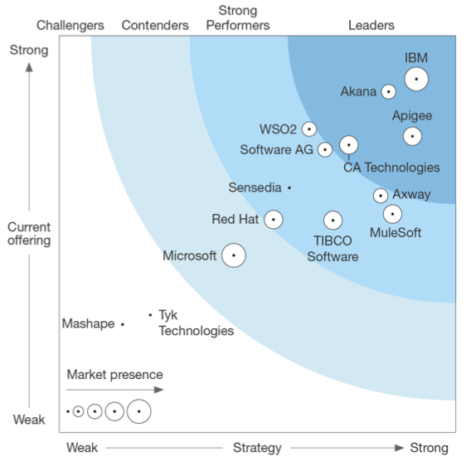
IBM API Connect: Ranked #1
Ranked as Leader by all Analysts
Forrester, Gartner, IDC, Ovum
Trusted by enterprises of all sizes across industries and geographies
500+ API Connect clients
2,000+ DataPower Gateway clients
Forrester Wave

Slide 6
Secure your APIs with Industry leading API Gateway
Secure to the core with signed, encrypted gateway image without external software dependencies to minimize risk
Proven API security policies at runtime to quickly protect services and data across multi-clouds
Performant & scalable architecture to help meet SLAs and improve client user experience
Optimized drag & drop built-in policies for security, traffic control & mediation to accelerate time to value
Flexible and extensible to align with enterprise requirements and enable quick customization
Notes:
Purpose-built, secure gateway image
Single self-contained, signed & encrypted secure gateway image without external software dependencies
No arbitrary software
Security exposure minimized due to smaller vulnerability surface (few user-exposed and 3rd party components)
High assurance, “locked-down” configuration
Optimized, embedded operation system
Parsers, compilers and runtime for JSON & XML processing written from ground-up
Secure and optimized JavaScript runtime
Non-blocking event-driven I/O architecture
Available in Cloud, Virtual and Physical form factors

Slide 7
Manage the Lifecycle of your APIs
Define & Import REST or SOAP APIs to put those assets under governance
Package APIs into Products and tailor them to target specific consumer markets
Publish and Promote across different environments to align with DevOps practices
Manage and Control API Lifecycle and versioning from staging to deprecation to meet corporate governance needs
Subscription and Community management to grow go-to-market channels

Slide 8
Socialize and Engage with API Consumers to drive adoption
Self-service, branded Portal across multiple API provider lines of businesses within an organization to socialize APIs
Engage with API consumers via community building features: blogs, forums, ratings etc.
Governance & autonomy to each provider organization to manage their APIs, products, plans and multiple gateway endpoints independently within their ‘Space’

Slide 9
Monetize your API Calls
Modern approach & intuitive user experience providing flexibility to define pricing details
Subscription pricing to enable recurring payments, popular in SaaS go-to-market strategies
Stripe integration OOTB for smooth user-onboarding and payment collection
Analytics, customizable reports for detailed insights into revenue, usage of monetized APIs
Offload API usage data to existing enterprise tools to handle customized invoicing processes

Slide 10
Gain Insights into your API Usage
Analyze API calls to get visibility and understand API consumption
Who & What is Driving my API Business?
What are the response times of my APIs ?
Drill down and build custom queries for deeper analysis
Build custom dashboards and share to address specific reporting and visualization needs
Offload usage data to external systems like Splunk or your own Elastic stack

Slide 11
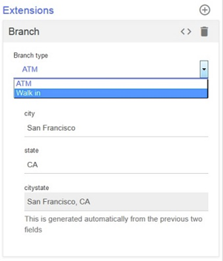
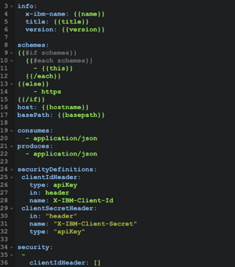

Accelerate API Developer Productivity
Enforce corporate standards through templates for API and API Product definitions
Simplify API categorization & search through customer defined metadata
API Gateway behavior control based on the additional metadata
Integrated Loopback Experience for Interaction tier
Integrated with API Connect Toolkit for simpler user experience to create APIs
LoopBack

Slide 12
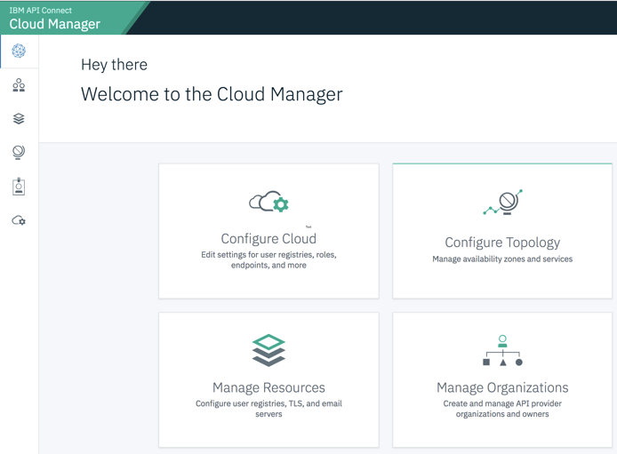

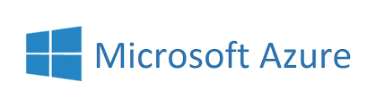

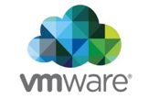


And Deploy your API strategy ANYWHERE…
Multi-cloud API Gateway cluster support co-located with provider backends on virtually any cloud, managed within a single API Connect deployment
Container/Kubernetes & VMware support for API Connect components to run virtually anywhere
Unmatched scalability and performance through new container and microservices based design
Independently scale API Connect components leveraging container orchestration tools

Slide 13




















IBM API Connect: Customer Success Stories
400+ Clients

Slide 14
Agenda
IBM API Connect Overview
What’s New in API Connect
IBM API Connect on IBM Cloud Private
Resources

Slide 15





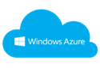

Central Management of APIs across Multi-Cloud Deployments
Single-tenant, IBM managed API Connect with co-located DataPower API Gateway on any Cloud
Your API Connect with co-located DataPower API Gateway on any Cloud
OR
IBM Managed
API Connect
Customer Managed
API Connect
API Connect Reserved Instance in IBM Cloud
API
API Connect in Public Cloud
OR On-premises
API
API Gateway
API Gateway
Customer Managed
API Gateway
API Gateway
API Gateway
API Gateway
API Gateway
API
API
API
API
On-Premises

Slide 16

API Connect V2018.x: Deployment Options
New Docker-based images with K8 orchestration for container based deployments on a customer managed K8 environment or on IBM Cloud Private
VMWare OVA support for clients to run on their existing established enterprise virtualization platform
Customer modifiable open VM images based on standard Ubuntu OS for clients to customize based on corporate governance needs
API Gateway available in hardened cloud, virtual and physical appliance form factors to improve security and time to value

Slide 17
API Connect V2018.x: Component options
Standalone API Analytics component to scale independently based on API project growth
Zero to N portal clusters can be configured to a API Connect deployment to align with API project growth
Native install of APIC toolkit for enhanced user experience
V5 to V2018 Upgrade through automated migration scripts with a parallel stack setup following modern software practices, coming 2Q18

Slide 18
API Connect V2018.x & DataPower V7.7 on IBM Cloud Private
Securely expose business services and data in IBM Cloud Private as APIs to accelerate innovation
Production-ready DataPower Gateway on Docker, running in < 1 minute, to accelerate time to value
Native support for API Connect with optimizations for logging and monitoring into IBM Cloud Private platform services to reduce total cost of ownership
Scale Individual API Connect components through IBM Cloud Private’s Kubernetes Platform for simplified scalability and response to unplanned usage spikes

Slide 19
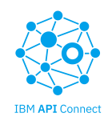
ISTIO + API Connect: API Management for your Microservices
IBM, along with Google, is a primary contributor to Istio project. IBM API Connect & Gateway offerings plan to integrate with this strategic platform enabling clients to …
DataPower
API Gateway
Complement API management with microservices management using Istio
Expose APIs to external consumers using DataPower Gateway, combining API security with Kubernetes load balancing and monitoring
End-to-end transaction tracing using Zipkin to provide enhanced operational visibility across microservices and APIs
REST
REST
Microservice
Microservice
REST
REST
Microservices
application
Microservice
Messaging
Microservice
Microservice

Slide 20
Agenda
IBM API Connect Overview
What’s New in API Connect
IBM API Connect on IBM Cloud Private
Resources

Slide 21
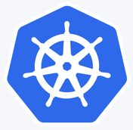
IBM Cloud Private Content - Kubernetes
Core Operational Services
Open Source
IBM Software
Monitoring Service
Prometheus or BYO
Logging Service
Elk or BYO
Metering Service
Product Insights
Security
Identify and Access Management
LDAP integration and RBAC
Vulnerability Advisor (beta)
Toolchains & Runtimes
Jenkins
Apache Tomcat Open Liberty
Messaging
RabbitMQ
Data Services
MongoDB
PostgreSQL
Redis
Clustering
Galera
Http Servers
Nginx
Terminal Access
Web Terminal
Toolchain & Runtimes
IBM Microservice Builder
IBM WebSphere Liberty
IBM SDK for Node.js
Messaging
IBM MQ Advanced for Developers IBM MQ Advanced
Data Services
IBM Db2 Dev-C
IBM Data Server Manager (for Db2 Dev-C)
IBM Db2 Direct Advanced Edition / AESE
with Data Server Manager
IBM Db2 Warehouse Dev-C
IBM Db2 Warehouse Enterprise*
IBM Cloudant Developer Edition
Multi-cloud Management
IBM Cloud Automation Manager
Data Science
IBM Data Science Experience Developer Edition
IBM Data Science Experience Local*
Integration
IBM Integration Bus for Developers
IBM Integration Bus
IBM DataPower Gateway for Developers
IBM DataPower Gateway Virtual Edition
IBM API Connect
App Modernization Tooling
IBM Transformation Advisor
Monitoring
IBM Cloud Application Performance Management for DevOps (beta)
HPC
IBM Spectrum LSF Community Edition
*coming soon
+
Develop or bring your own…
Self written, community and open source compatible with Kubernetes 1.7

Slide 22
Adding Purchased IBM Software to your Catalog
Purchased IBM Software is entitled in PPA
1. Download from Passport Advantage
2. Import locally into IBM Cloud Private (ICP)
Purchased IBM software is provided with IPLA license.
Some software maybe sold with priced metrics other than VPC. Client is responsible for compliance to those metrics.
Several packages are entitled for production use and S&S through ICP Cloud Native and Enterprise editions, but are only accessed from IBM Charts repo and public Docker registries. This includes Microservice Builder, WebSphere Liberty and Node.js runtimes.

Slide 23
Resources used for DEV Environment
 | Nodes | Cores | Memory (GB) | Diskspace (GB)
Boot/Master | 1 | 8 | 32 | 250
Mgmt | 1 | 8 | 32 | 250
Proxy | 1 | 4 | 16 | 250
Worker | 4 | 8 | 32 | 250
Gluster FS | 3 | 4 | 16 | 540
Total | 10 | 64 | 256 | 3370

Slide 24
IBM API Connect running on IBM Cloud Private
Kubernetes Cluster
Master Node
Management Node
Proxy Node
Worker Node
Worker Node
Worker Node
Worker Node
Pod
Pod
Pod
Pod
Pod
Pod
Pod
Pod
Pod
Pod
Pod
Pod
IBM API Connect Container
IBM API Connect Container
IBM API Connect Container
IBM API Connect Container
Docker
Docker
Docker
Docker
Namespace -> apiconnect
Calico

Slide 25
IBM API Connect Helm Chart - ibm-apiconnect-ent V2.0.3 (1/10) Operator Configuration
Parameter name | Value | Default value (if any) | Description
image.repository | mycluster.icp:8500/apiconnect/apiconnect-operator | apiconnect-operator | IBM API Connect operator image repository
image.pullPolicy | IfNotPresent | IfNotPresent | IBM API Connect operator image pull policy
image.tag | 2018-05-31-17-25-34-e0b91ac02e5aaad904c90c01854aff6df3c0606a |  | IBM API Connect operator image tag
Note: The defaults shown when configuring the Helm Chart using UI can be used without any modification

Slide 26
IBM API Connect Helm Chart - ibm-apiconnect-ent V2.0.3 (2/10) Common Configuration
Parameter name | Value | Default value (if any) | Description
registry | mycluster.icp:8500/apiconnect/ |  | Registry containing IBM API Connect images
registrySecret | apiconnect-icp-secret |  | Image pull secret
storageClass | apic.shared.storage |  | Storage class
helmTlsSecret | helm-tls-secret |  | Secret with items for base64-encoded helm key.pem, cert.pem, and ca.pem
Note: The ICP artifacts apiconnect-icp-secret, apic.shared.storage and helm-tls-secret should be created before the installing the helm chart

Slide 27
IBM API Connect Helm Chart - ibm-apiconnect-ent V2.0.3 (3/10) Management subsystem Configuration
Parameter name | Value | Default value (if any) | Description
enabled | TRUE | TRUE | Enable the Management subsystem
platformApiEndpoint | apicplatform.INGRESS_CTRL_IP.nip.io |  | Platform API endpoint
consumerApiEndpoint | apicconsumer.INGRESS_CTRL_IP.nip.io |  | Consumer API endpoint
cloudAdminUiEndpoint | apiccloud.INGRESS_CTRL_IP.nip.io |  | Cloud Administrator UI endpoint
apiManagerUiEndpoint | apicmanager.INGRESS_CTRL_IP.nip.io |  | API Manager UI endpoint
searchMaxMemoryGb | 2 | 2 | Maximum amount of memory (in gigabytes) that is available for search
searchVolumeSizeGb | 50 | 50 | Storage volume size for ES cluster
externalCassandraHost |  |  | Optional separate Cassandra host
Note: The endpoints can be refined using the IP address of the Ingress Controller in the IBM Cloud Private environment.

Slide 28
IBM API Connect Helm Chart - ibm-apiconnect-ent V2.0.3 (4/10) Cassandra cluster Configuration
Parameter name | Value | Default value (if any) | Description
cassandraClusterSize | 1 | 3 | Number of nodes in the Cassandra database management cluster.
cassandraMaxMemoryGb | 8 | 16 | Maximum memory (in gigabytes) available to the Cassandra database management
cassandraVolumeSizeGb | 16 | 16 | Storage volume size (in gigabytes) of the Cassandra database
Note: The defaults shown when configuring the Helm Chart using UI can be used without any modification

Slide 29
IBM API Connect Helm Chart - ibm-apiconnect-ent V2.0.3 (5/10) Cassandra backup Configuration
Parameter name | Value | Default value (if any) | Description
cassandraBackupAuthSecret |  |  | Auth secret for cassandra backup
cassandraBackupPath |  |  | Host for cassandra backup
cassandraBackupPath | /backups | /backups | Path for the Cassandra database management backup
cassandraBackupPort | 22 | 22 | Port for the Cassandra database management backup
cassandraBackupProtocol | sftp | sftp | Protocol for the Cassandra database management backup
cassandraBackupSchedule | 0 0 *** | 0 0 *** | Schedule for the Cassandra database management backup
Note: The defaults shown when configuring the Helm Chart using UI can be used without any modification

Slide 30
IBM API Connect Helm Chart - ibm-apiconnect-ent V2.0.3 (6/10) Cassandra postmortems Configuration
Parameter name | Value | Default value (if any) | Description
cassandraPostmortemsAuthSecret |  |  | Auth secret for cassandra postmortem upload
cassandraPostmortemsHost |  |  | Host for cassandra postmortem upload
cassandraPostmortemsPath | /cassandra-postmortems | /cassandra-postmortems | Path for the Cassandra postmortem upload
cassandraPostmortemsPort | 22 | 22 | Port for the Cassandra postmortem upload
cassandraPostmortemsProtocol | sftp | sftp | Protocol for the Cassandra postmortem upload
Note: The defaults shown when configuring the Helm Chart using UI can be used without any modification

Slide 31
IBM API Connect Helm Chart - ibm-apiconnect-ent V2.0.3 (7/10) Portal subsystem Configuration
Parameter name | Value | Default value (if any) | Description
enabled | TRUE | TRUE | Enable the Developer Portal subsystem
portalDirectorEndpoint | apicpadmin.INGRESS_CTRL_IP.nip.io |  | Developer Portal Admin endpoint
portalWebEndpoint | apicportal.INGRESS_CTRL_IP.nip.io |  | Developer Portal web endpoint
adminStorageSizeGb | 1 | 1 | Storage volume size (in gigabytes) for Admin data
backupStorageSizeGb | 5 | 5 | Storage volume size (in gigabytes) for backups
dbLogsStorageSizeGb | 2 | 2 | Storage volume size (in gigabytes) for logs
dbRootPw | root | root | Database root password
dbStorageSizeGb | 12 | 12 | Storage volume size for Developer Portal database
wwwStorageSizeGb | 5 | 5 | Storage volume size for Developer Portal database
Note: The endpoints can be refined using the IP address of the Ingress Controller in the IBM Cloud Private environment.

Slide 32
IBM API Connect Helm Chart - ibm-apiconnect-ent V2.0.3 (8/10) Analytics subsystem Configuration
Parameter name | Value | Default value (if any) | Description
enabled | TRUE | TRUE | Enable the Analytics subsystem
analyticsIngestionEndpoint | apicai.INGRESS_CTRL_IP.nip.io |  | Analytics ingestion endpoint
analyticsClientEndpoint | apicac.INGRESS_CTRL_IP.nip.io |  | Analytics client endpoint
coordinatingMaxMemoryGb | 3 | 6 | Maximum memory (in gigabytes) for defining analytics visualizations
dataMaxMemoryGb | 4 | 8 | Maximum memory (in gigabytes) for data
dataStorageSizeGb | 50 | 50 | Storage volume size (in gigabytes) for ElasticSearch data
masterMaxMemoryGb | 4 | 8 | Maximum memory (in gigabytes)
masterStorageSizeGb | 1 | 1 | Storage volume size (in gigabytes) for ElasticSearch master
Note: The endpoints can be refined using the IP address of the Ingress Controller in the IBM Cloud Private environment.

Slide 33
IBM API Connect Helm Chart - ibm-apiconnect-ent V2.0.3 (9/10) Gateway subsystem Configuration
Parameter name | Value | Default value (if any) | Description
enabled | TRUE | TRUE | Enable the Gateway subsystem
apiGatewayEndpoint | apicapi-gateway.INGRESS_CTRL_IP.nip.io |  | Gateway host name
gatewayServiceEndpoint | apicapic-gateway-director.INGRESS_CTRL_IP.nip.io |  | Gateway Director endpoint
maxCpu | 2 | 4 | Maximum CPU resources that are available to the gateway.
maxMemoryGb | 6 | 8 | Maximum memory (in gigabytes) for the gateway
Note: The endpoints can be refined using the IP address of the Ingress Controller in the IBM Cloud Private environment.

Slide 34
IBM API Connect Helm Chart - ibm-apiconnect-ent V2.0.3 (10/10) Overrides Configuration
Parameter name | Value | Default value (if any) | Description
mode | standard | standard | Deployment type
Note: This option is available only when installing silently using values.yaml

Slide 35
IBM API Connect – Sample list of services

Slide 36
IBM API Connect – Sample list of pods

Slide 37
Advantages of running IBM API Connect on IBM Cloud Private
Removes the typical operational challenges faced in the Enterprise like Security/Patching/Restart
Provides the ability to scale elastically
Most IBM middleware including IBM API Connect are already containerized and are available as Helm Chart
Deploying and updating software at scale
Allows one common dashboard for monitoring and logging all IBM services and the customer application

Slide 38






What do Kubernetes really offer ?
Intelligent Scheduling
Automatically places containers based on their resource requirements and other constraints, while not sacrificing availability. Mix critical and best-effort workloads in order to drive up utilization and save even more resources.
Self Healing
Restarts containers that fail, replaces and reschedules containers when nodes die, kills containers that don't respond to your user-defined health check, and doesn't advertise them to clients until they are ready to serve.
Horizontal Scaling
Scale your application up and down with a simple command, with a UI, or automatically based on CPU usage.
Service Discovery and Load Balancing
No need to modify your application to use an unfamiliar service discovery mechanism. Kubernetes gives containers their own IP addresses and a single DNS name for a set of containers, and can load-balance across them.
Automated rollout and rollback
Kubernetes progressively rolls out changes to your application, while monitoring application health to ensure it doesn't kill all your instances at the same time. If something goes wrong, Kubernetes will rollback the change for you. Take advantage of a growing ecosystem of deployment solutions.
Secret and configuration management
Deploy and update secrets and application configuration without rebuilding your image and without exposing secrets in your stack configuration.

Slide 39
Agenda
IBM API Connect Overview
What’s New in API Connect
IBM API Connect on IBM Cloud Private
Resources

Slide 40
Resources
https://www.ibm.com/support/knowledgecenter/en/SSMNED_2018/mapfiles/getting_started.html
https://developer.ibm.com/apiconnect/
https://developer.ibm.com/datapower/docker/

Slide 41
Thanks!

Slide 42
Backup Slides

Slide 43


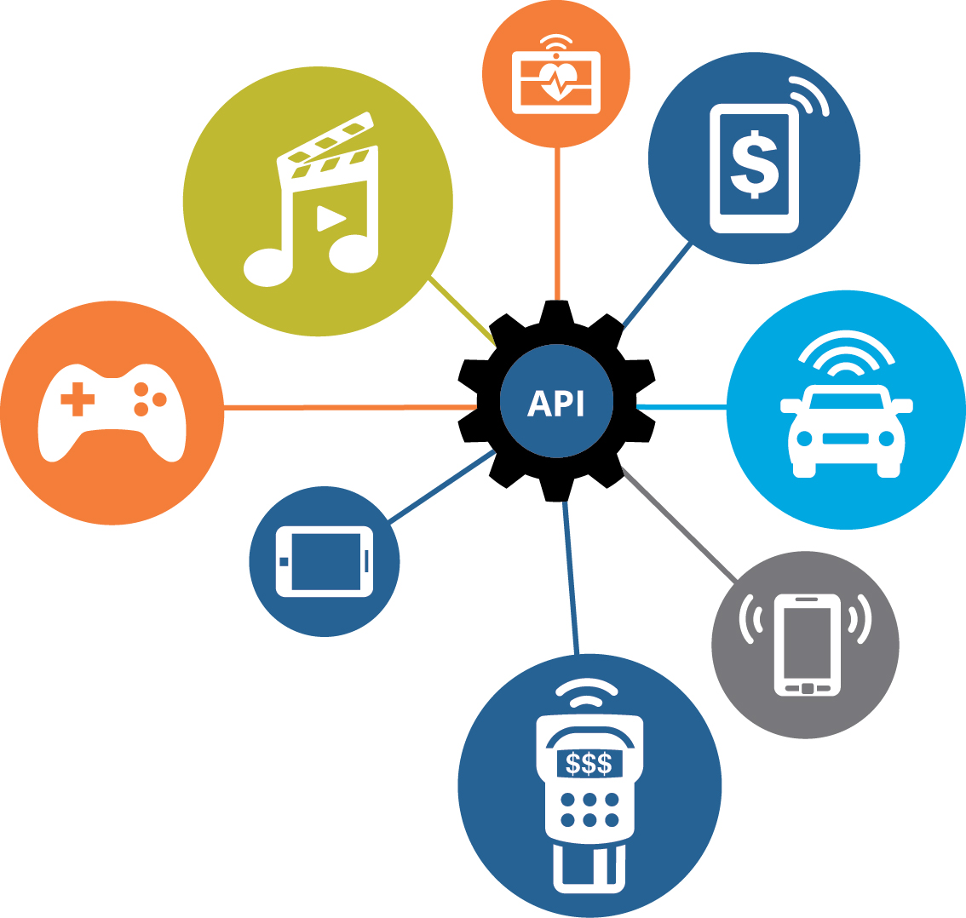
Web, Mobile & APIs Offer Organizations…
Late 1990s
2000s
2015+
Notes:
What do these 3 technology, each separated by 10-15 years have in common?
What can they offer your organization?

Slide 44
Web, Mobile & APIs Offer Organizations…
A new channel to:
Reach clients & partners
Enable new businesses models
1
2
Notes:
A new channel for businesses arrives approximately every 10 years (i.e. Web in 1990s, Mobile in 2000s, and now APIs in 2015+).
When thinking of your Web or Mobile strategy, it wasn’t about technology. It was about business opportunities. The same is true for APIs. This is the first major new channel to reach new markets and unlock new business models that your business has been presented with.
Can you afford to ignore it? Of course you cannot; just like your business couldn’t afford to ignore the web and ecommerce as a new channel for your organization.

Slide 45


What do the Following Have in Common?
Coffee company goes digital, builds $1.6B payments business, drives 21% of transactions
Car company offers connected car, improves driving experience, sells vehicle data to partners
Bank spurs innovation by offering hackathons, integrates rewards program with retailer partners
Digital disruption fueled by API’s

Slide 46
How Do We Extend Our Reach?
Opportunity
Potential Customers
Reach
Untapped Opportunity
Web Site
In Person
Business Offerings
Transactions, Data, Content, …

Slide 47
Enabling the New Channel
Opportunity
Potential Customers
Reach
Extended Reach
Mobile Apps
Partnering
B2B
Social Networks
3rd Party Apps
IoT / Devices
Web Site
In Person
Business APIs
Business Offerings
Transactions, Data, Content, …

Slide 48
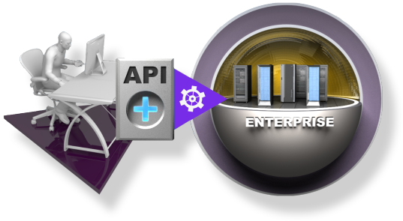
Business API = Web API = Productized Service
What is a Business API?
A Business API is a public persona for an enterprise; exposing defined assets, data or services for public consumption
A Business API is simple for app developers to use, access and understand
A Business API can be easily invoked
What Value Does a Business API Provide?
Extends an enterprise and opens new markets by allowing external app developers to easily leverage, publicize and/or aggregate a company’s assets for broad-based consumption
What “assets, data or services” are exposed via a Business API?:
Product catalogs
Store listings
Order status
Inventory
Social interaction
App Developer

Slide 49
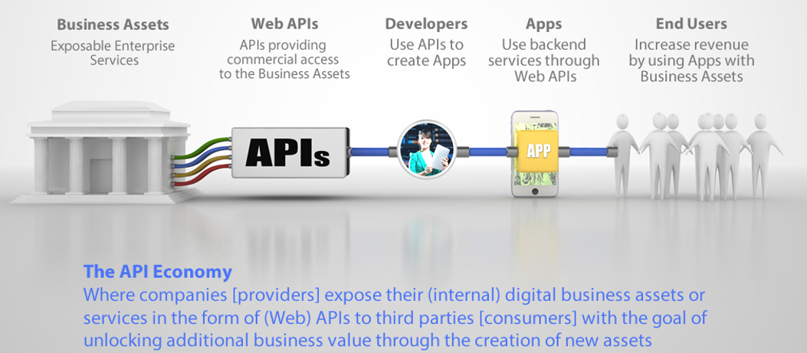
API Economy Supply Chain
Focus Here
Not Here
Notes:
* Expose functionality as APIs
* Make APIs available for reuse internally and externally
* Reuse raises ROI, increases competitiveness

Slide 50

What API Use Cases Can You Think Of?

Slide 51

Investments in Industry Ecosystems
Banking
BIAN REST APIs
IBM is working with the Banking Industry Architecture Network (BIAN) to create common IT standards for the banking industry, specifically:
IBM created common banking API definitions based on BIAN standards.
IBM has created REST APIs based on BIAN standards so banks won’t have to start from scratch to create their APIs. This move will also help standardize application components and simplify and accelerate the creation of applications.
REST APIs are on a portal in IBM Bluemix at ibm.biz/bianapiportal
“We are pleased to be working with IBM to promote banking industry standards and encourage collaborative, innovative solutions for banks. .. IBM’s sharing of banking industry APIs – with the additional operational value from IBM’s Banking Industry models – will accelerate development, propel adoption and set the stage for enhanced business benefits and future growth.”
– Hans Tesselaar, Executive Director, BIAN

Slide 52
Where are you in your API Economy journey?
Understand Your API Maturity Level
Where do you start?
Do you have an API Strategy?
What changes need to be considered, IT & Business??
Who needs to participate?
Do you have the right roles / responsibilities in place for driving this transformation?
What expectations does the business have?
Do you have existing SOA infrastructure?
What’s the difference and how can I leverage the investment in SOA?

Slide 53

Typical Audiences
Private, Internal APIs
Protected, Open-To-Partner APIs
Public, Open-To-All APIs

